Slide 1


LIFE SKILLS
GRADE 2
YEAR 1 TERM 2
BEGINNING KNOWLEDGE AND PERSONAL AND SOCIAL WELLBEING

Slide 2
OUTLINE
DURATION | CONTENT AREA
Week 1 & 2 | Seasons
Week 3 & 4 | Creatures living in water, Ocean, River and Pond
Week 5, 6 & 7 | Animals and their shelters
Week 8 & 9 | Farm and wild animals

Slide 3
WEEK 1 & 2
SEASONS

Slide 4
LESSON OBJECTIVES
The learner must be able to:
Name four seasons
Discuss how seasons affect our - clothes, food and activities
Understand how seasons affect growing things - sowing, growing and harvesting
Discuss how seasons affect animals - include farming e.g., sheep shearing, animal dipping; birds e.g. migration and nesting

Slide 5
ASSEESSMENT GOALS
Name and discuss the four seasons according to their characteristics
Explain how the seasons affect animals

Slide 6

SEASONS

Slide 7
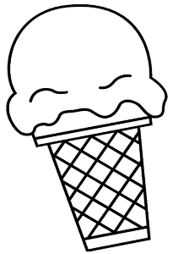
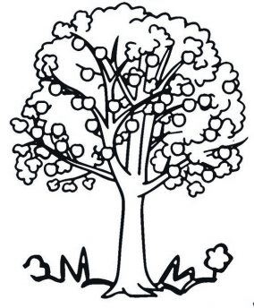
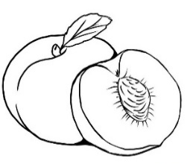
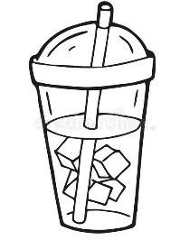

GROUP 1
Task 1: Colour the food pictures that you will eat during summer and winter
Summer | Ice cream peaches cold drink Milo

Slide 8
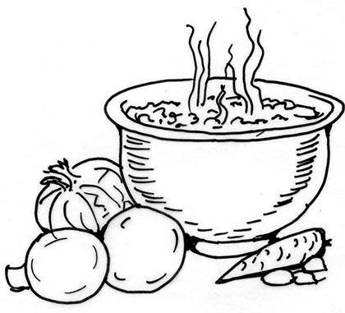
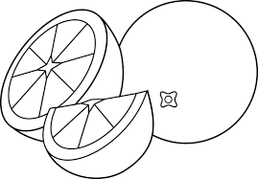
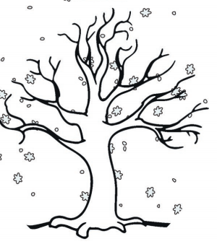
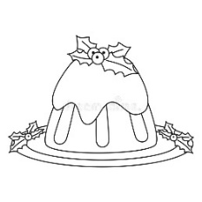
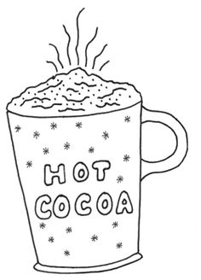
Task 1 cont…
Winter | soup oranges Chrismas pudding Hot chocolate

Slide 9
GROUP 1
Task 2: Cut, match and paste the clothes to wear during the seasons

Slide 10
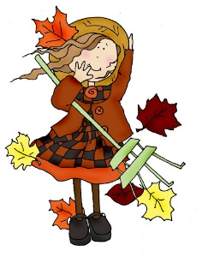
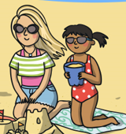
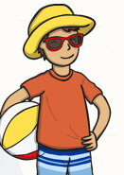
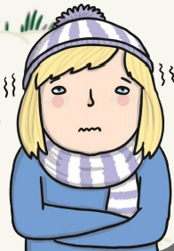
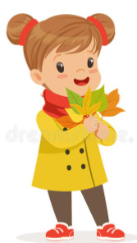
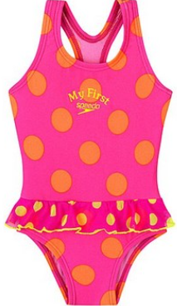
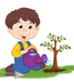
Task 2 cont…
Cut the pictures and paste in the correct spaces on the previous page
 ---------------------------------------------------------------------------------------------------------------------------

Slide 11
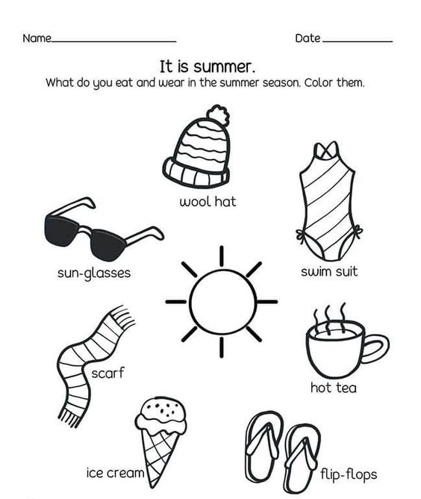
Group 2
Task 1: What do you eat and wear in the summer season. Colour them

Slide 12
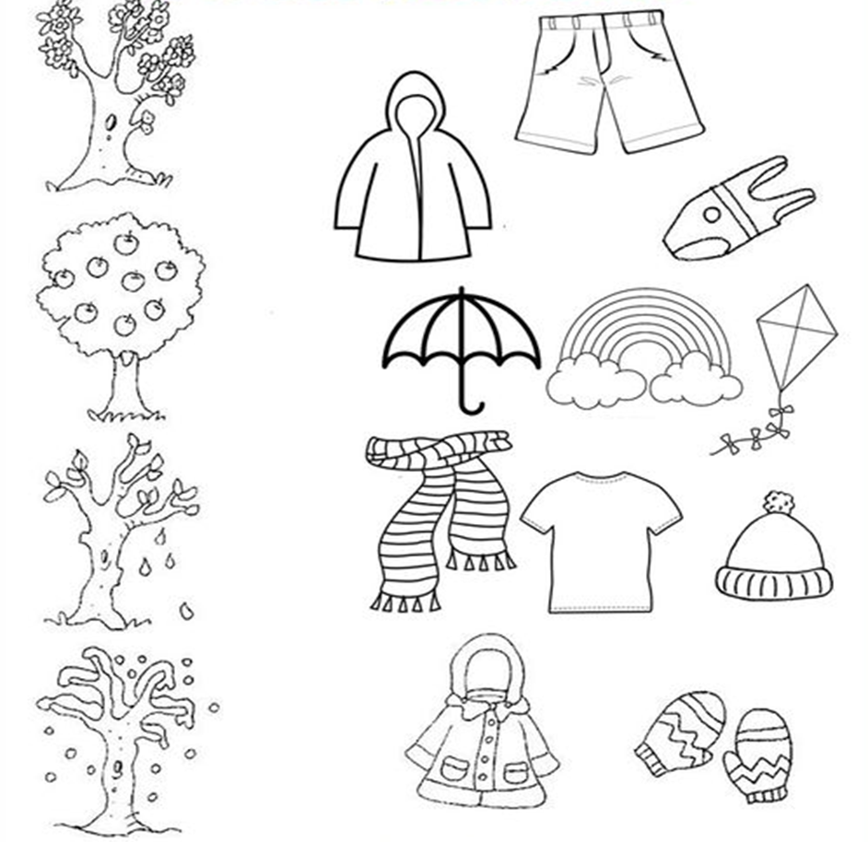
GROUP 2
Task 2: Match the following pictures with the correct season.

Slide 13
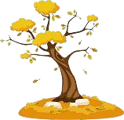

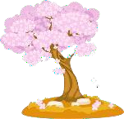
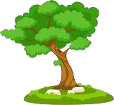

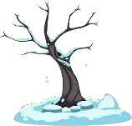
GROUP 3
Task 1: Match the seasons to the pictures.
Spring
Autumn

Slide 14
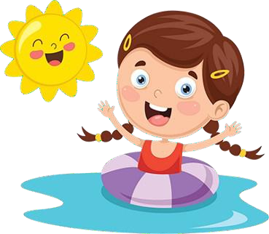
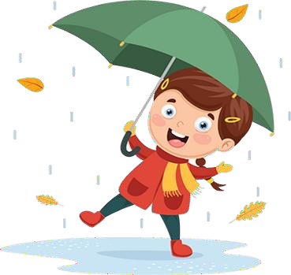
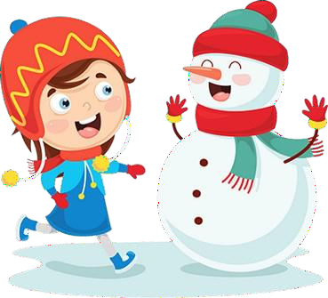
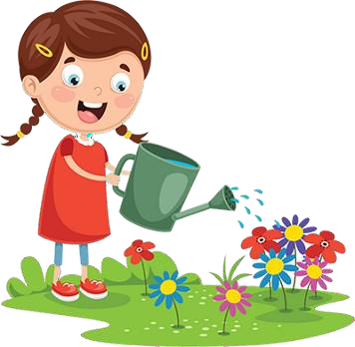
Group 3
Task 2: Write the word for the season shown.
Spring Autumn Winter Summer

Slide 15
WEEK 3 & 4
CREATURES LIVING IN WATER, OCEAN, RIVER AND POND

Slide 16
LESSONS OBJECTIVES
The learner must be able to:
Compare salt/fresh water
Identify land animals (All animals done up to now)
Identify water animals - River - e.g. fish, crocodile, hippo, crabs, Ponds and dams - e.g. fish, frog, dragonfly, Salt water - Sea - e.g. fish - shark, dolphin
Compare characteristics of land animals with water animals

Slide 17
ASSESSMENT GAOLS
Compare water and land animals according to their characteristics
Know which of the animals above live in rivers/ponds/ocean

Slide 18
CREATURES LIVING IN WATER, OCEAN, RIVER AND POND

Slide 19
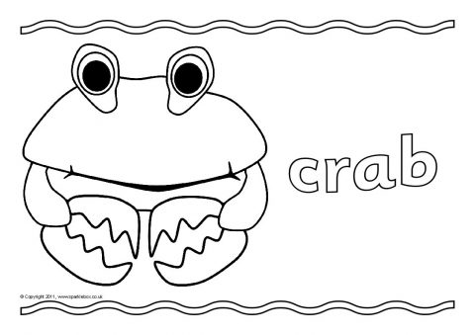
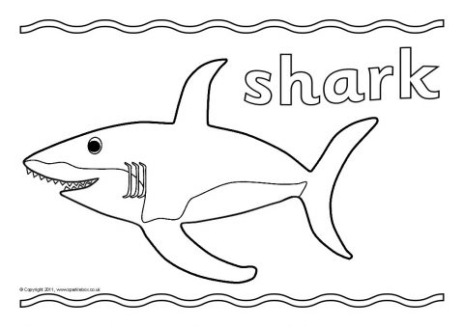
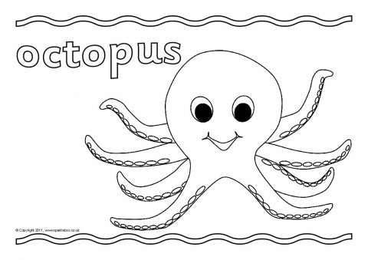
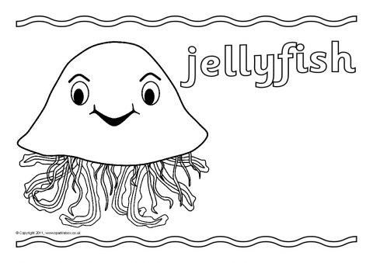
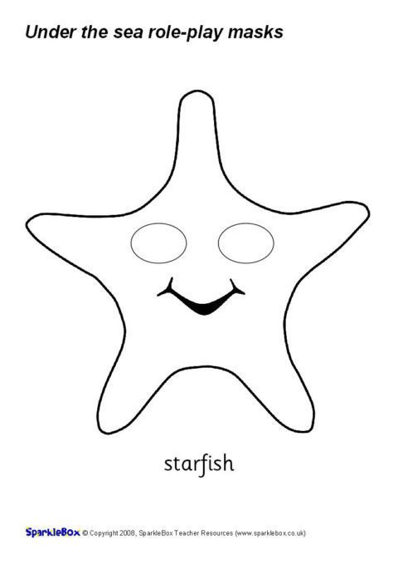
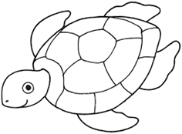
GROUP 1
Task 1: Colour the animals that live in the ocean.
Starfish
Sea turtle

Slide 20
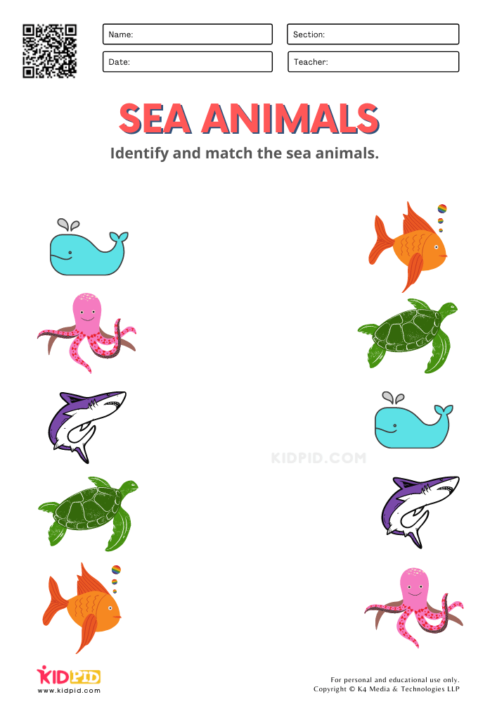
GROUP 1
Task 1: Match the sea animals.

Slide 21
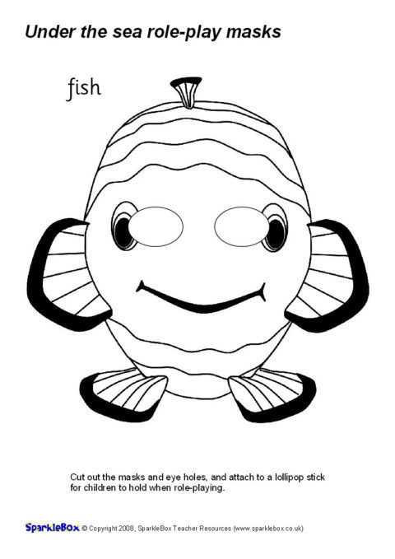
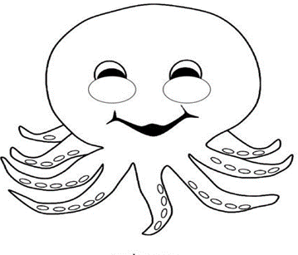
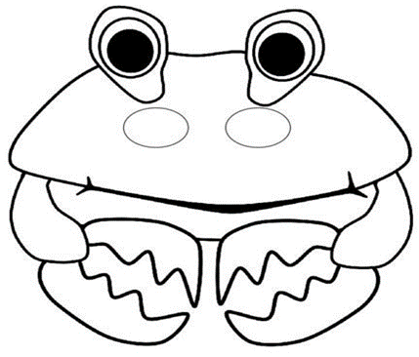
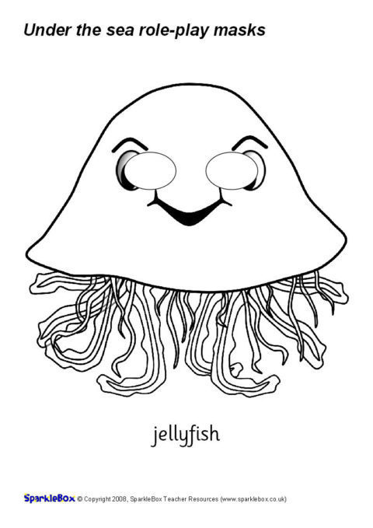
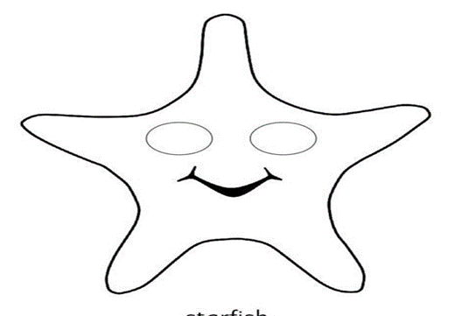
GROUP 2
Task 1: Colour and trace the animals that live in the ocean.
fish | octopus | crab
Sea turtle | jellyfish | starfish

Slide 22
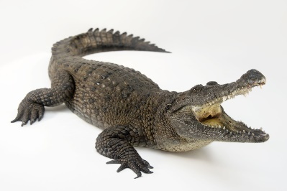
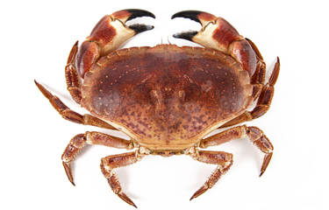
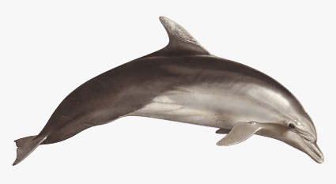
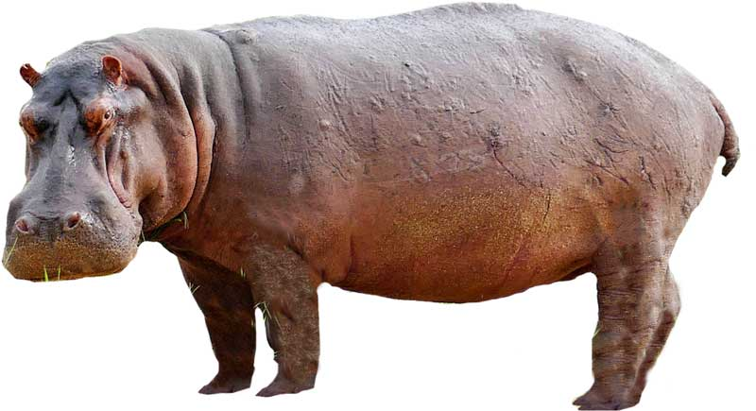
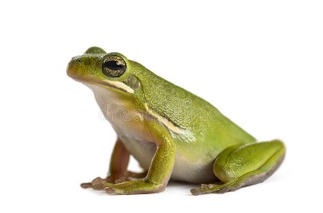
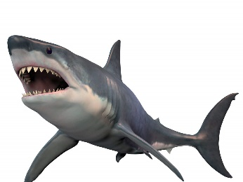
GROUP 3
Task 2: Identify and label water animals. Use the words in the word box.

Slide 23
Task 1 cont…
dolphin | frog | crab
shark | crocodile | hippopotamus

Slide 24
GROUP 3
Task 2: Draw your favourite water animals.

Slide 25
WEEK 5, 6 & 7
Animals and their shelters

Slide 26
LESSON OBJECTIVES
The learner must be able to:
Identify animals and creatures that make their homes - such as birds, some bees, ants, spiders etc.
Identify animals and creatures that find their homes - such as baboons, snakes, squirrels etc.
Identify animals and creatures that carry their homes - such as snails, tortoises etc.

Slide 27
ASSESSMENT GOALS
Explain and compare the purpose of the homes of animals

Slide 28
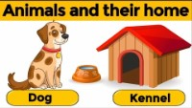
ANIMALS AND THEIR SHELTERS

Slide 29
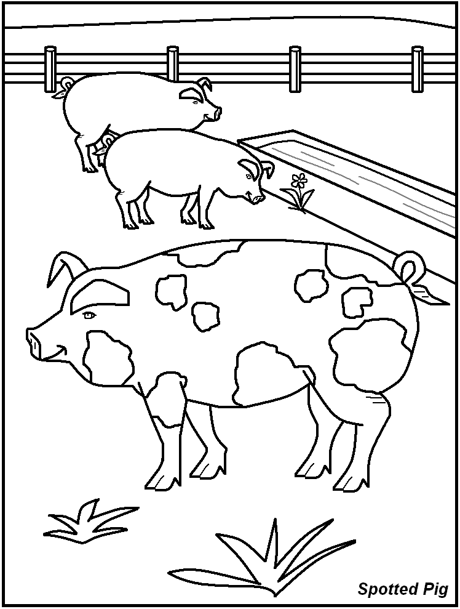
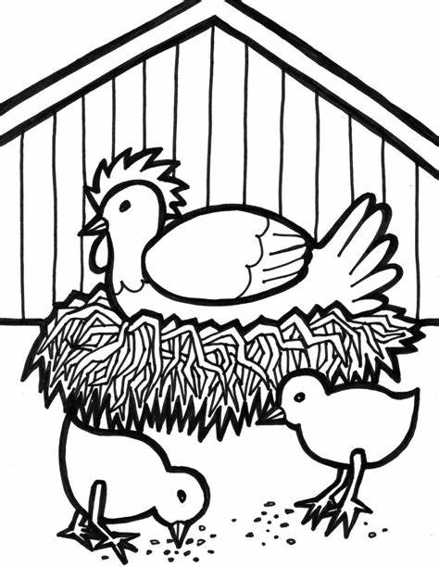
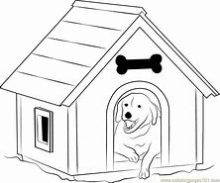
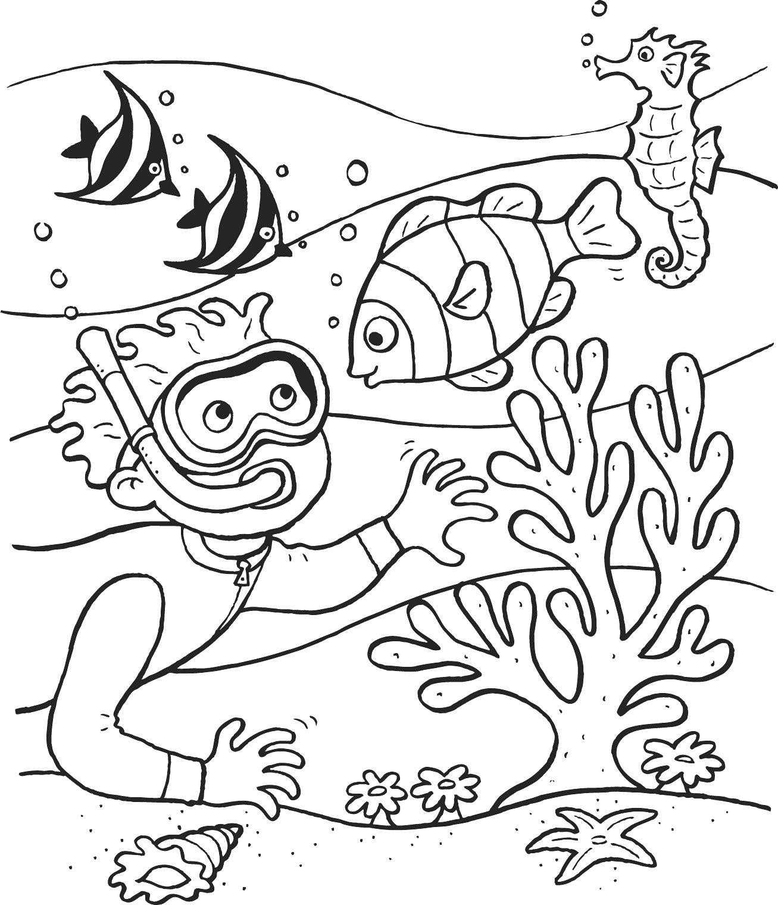
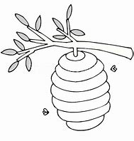

Group 1
Task 1: Colour the animal homes below.

Slide 30

GROUP 1
Task 2: Cut and paste each animal home in front of the animal

Slide 31


GROUP 2
Task 1: Match the images on the left with their corresponding images on the right.

Slide 32





GROUP 2
Task 2: Identify the type of animal that lives each picture below.
 |  | cave
 |  | kennel
 |  | den
 |  | pond
 |  | coop

Slide 33

Group 3
Task 1: All living things need shelter to protect them. Tick √ the correct animal home.

Slide 34






GROUP 3
chicken coop cave coral reefs spiderweb
Task 2: Write in the name of the home.

Slide 35
WEEK 8 & 9
FARM AND WILD ANIMALS

Slide 36
LESSON OBJECTIVES
Identify/name and compare different farm animals
Understand uses of farm animals such as food and clothing
Identify/name and compare wild animals
Understand the meaning of camouflage
Compare camouflage of farm and wild animals

Slide 37
ASSESSMENT GOALS
Understand the meaning of camouflage
Compare camouflage of farm and wild animals

Slide 38

FARM AND WILD ANIMALS

Slide 39
GROUP 1
Task 1: Look at the picture and talk about the different farm animals you see.

Slide 40




GROUP 1
Task 2: Colour the wild animals below.

Slide 41
GROUP 2
Task 1: Match the pictures to the word.

Slide 42





Group 2
Task 2: Trace the words then write in the space next t it.
 | tiger
 | Fox
 | elephant
 | lion
 | deer

Slide 43

GROUP 3
Task 1: Cut and paste the pictures below to match the animal names.

Slide 44
GROUP 3
Task 2: Identify and label the pictures of the farm animals below.

Slide 45
Task 1: cont.…
dog horse pig chicken duck cow donkey sheep goat

Slide 46
Resources
www.k5learning.com
www. sparklebox.co.uk
www.twinkl.co.za
www.Pinterest.com

